Slide 1
Secure Routing and Forwarding
06
Kai Bu
kaibu@zju.edu.cn
http://list.zju.edu.cn/kaibu/netsec
Notes:
In previous lectures, we use https to showcase how two communication entities (e.g., a client and a server) exchange messages to build a secure connection over public internet.
However, how packets are transmitted in between the client and the server is kept transparent to them, right?
Specifically, both the client and the server do not know which route their packets have followed, let alone to control the route selection process.
These two incapabilities touch exactly the two fundamental building blocks of traffic management, which are

Slide 2
Secure Routing and Forwarding
Notes:
Routing and forwarding.

Slide 3
Secure Routing and Forwarding
select a path for traffic in a network
Notes:
By definition
Routing is the process of selecting a path for traffic in a network, or between or across multiple networks.

Slide 4
Secure Routing and Forwarding
select a path for traffic in a network
relay packets along a certain path
Notes:
And forwarding is the relaying of packets along a certain path,
from one network segment to another by nodes in a computer network.

Slide 5
Secure Routing and Forwarding
How routing works?
How routing is attacked?
How routing is secured?
Notes:
Let’s first start with secure routing.
Discussions to be covered include routing’s working principles, vulnerabilities, and security solutions.

Slide 6
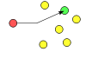
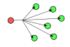
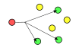
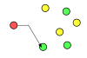
Delivery Scheme
unicast
deliver a message to a single specific node
broadcast
deliver a message to all nodes in the network
multicast
deliver a message to a group of nodes
anycast
deliver a message to any one out of a group
Notes:
Routing schemes differ in how they deliver messages:
unicast delivers a message to a single specific node
broadcast delivers a message to all nodes in the network
multicast delivers a message to a group of nodes that have expressed interest in receiving the message
anycast delivers a message to any one out of a group of nodes, typically the one nearest to the source
geocast delivers a message to a group of nodes based on geographic location
Unicast is the dominant form of message delivery on the Internet.

Slide 7
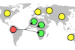
Delivery Scheme
unicast
deliver a message to a single specific node
broadcast
deliver a message to all nodes in the network
geocast
deliver a message to a group of nodes
based on geographic location
multicast
deliver a message to a group of nodes
anycast
deliver a message to any one out of a group
Notes:
geocast delivers a message to a group of nodes based on geographic location

Slide 8
Delivery Scheme
unicast
deliver a message to a single specific node
dominant form of msg delivery on Internet
Notes:
Unicast is the dominant form of message delivery on the Internet.
Build most of our discussions on it

Slide 9
Routing Scheme
unicast
deliver a message to a single specific node
how to find a feasible path?
Notes:
Now given the goal of delivering a message from one node to another, how to find a feasible path between them?
This is the focus of a routing scheme.

Slide 10
Routing Scheme
Intra-domain routing
inside an autonomous system
Inter-domain routing
between autonomous systems
Notes:
Depending on whether the two communication entities are in the same autonomous system,
There are two different routing schemes.
One is intra-domain routing, it targets path finding inside an autonomous system
The other is inter-domain routing, apparently, it aims to find paths between nodes from different autonomous systems.

Slide 11
Routing Scheme
Intra-domain routing
consider A-F as routers
Inter-domain routing
consider A-F as autonomous systems
5
B
3
C
2
5
A
2
1
F
3
1
2
D
E
1

Slide 12
Route Computation
Link-state algorithms
each router knows complete topology & link cost information;
independently run routing algorithm to calculate shortest path to each destination;
5
B
3
C
2
5
A
2
1
F
3
1
2
D
E
1
Notes:
route computation algorithms
link-state (Dijkstra)
each router knows complete topology & link cost information
Run routing algorithm to calculate shortest path to each destination
distance-vector (Bellman-Ford)
Each router knows direct neighbors & link costs to neighbors
Calculate the shortest path to each destination through an iterative process based on the neighbors distances to each destination

Slide 13
Dijkstra
c(i,j) link cost from i to j (∞ if unknown)
D(v) current value of cost of path from
source to destination v;
p(v) predecessor node along path from
source to v;
N’ set of nodes whose least
cost path is already known;
5
B
3
C
2
5
A
2
1
F
3
1
2
D
E
1
Notes:
c(i,j): link cost from node i to j (∞ if not known)
D(v): current value of cost of path from source to dest. V
p(v): predecessor node along path from source to v, (neighbor of v)
N': set of nodes whose least cost path already known

Slide 14
Dijkstra
1 Initialization:
2 N' = {A}
3 for all nodes v
4 if v adjacent to A
5 then D(v) = c(A,v)
6 else D(v) = ∞
7
8 Loop
find w not in N' such that D(w) is
minimum
10 add w to N'
11 update D(v) for all v adjacent to w and not in N':
12 D(v) = min(D(v), D(w) + c(w,v))
13 /* new cost to v is either the old cost, or known shortest path cost to w plus cost from w to v */
14 until all nodes in N'
5
B
3
C
2
5
A
2
1
F
3
1
2
D
E
1
Notes:
example

Slide 15
Dijkstra
Step
0
1
2
3
4
5
start N'
A
AD
ADE
ADEB
ADEBC
ADEBCF
D(B),p(B)
2,A
2,A
2,A
D(C),p(C)
5,A
4,D
3,E
3,E
D(D),p(D)
1,A
D(E),p(E)
infinity
2,D
D(F),p(F)
infinity
infinity
4,E
4,E
4,E
5
B
3
C
2
5
A
2
1
F
3
1
2
D
E
1

Slide 16
Dijkstra
Step
0
1
2
3
4
5
start N'
A
AD
ADE
ADEB
ADEBC
ADEBCF
D(B),p(B)
2,A
2,A
2,A
D(C),p(C)
5,A
4,D
3,E
3,E
D(D),p(D)
1,A
D(E),p(E)
infinity
2,D
D(F),p(F)
infinity
infinity
4,E
4,E
4,E
resulting shortest-path tree for A:
5
B
3
C
2
5
A
2
1
F
3
1
2
D
E
1

Slide 17
Dijkstra
Step
0
1
2
3
4
5
start N'
A
AD
ADE
ADEB
ADEBC
ADEBCF
D(B),p(B)
2,A
2,A
2,A
D(C),p(C)
5,A
4,D
3,E
3,E
D(D),p(D)
1,A
D(E),p(E)
infinity
2,D
D(F),p(F)
infinity
infinity
4,E
4,E
4,E
destination
link
B
(A, B)
D
(A, D)
E
(A, D)
C
(A, D)
F
(A, D)
resulting forwarding table at A:
5
B
3
C
2
5
A
2
1
F
3
1
2
D
E
1

Slide 18
what if no global view?
Notes:
Such link-state algorithms require that each router knows complete topology & link cost information;
What if a router has no such global view, especially in a relatively large network?

Slide 19
Route Computation
Distance-vector algorithms
each router knows direct neighbors & link costs to neighbors;
independently calculate shortest path to each destination through an iterative process based on neighbors’ distances to dest;
5
B
3
C
2
5
A
2
1
F
3
1
2
D
E
1
Notes:
In this case, we can turn to distance-vector algorithms;
distance-vector (Bellman-Ford)
Each router knows direct neighbors & link costs to neighbors
Calculate the shortest path to each destination through an iterative process based on the neighbors distances to each destination

Slide 20
Bellman-Ford
D_{x}(y) cost of least-cost path from x to y:
D_{x}(y) = min{c(x,y) + D_{v}(y)} for all neighbors v of x
5
B
3
C
2
5
A
2
1
F
3
1
2
D
E
1
Notes:
a typical distance-vector algorithm is Bellman-Ford
Define: D_{x}(y) := cost of least-cost path from x to y
Then D_{x}(y) = min {c(x,v) + D_{v}(y) }
where min is taken over all neighbors v of x

Slide 21
Bellman-Ford
D_{x}(y) cost of least-cost path from x to y:
wait for (change in local link cost of msg from neighbor)
recompute estimates
if DV to any dest has changed, notify neighbors
5
B
3
C
2
5
A
2
1
F
3
1
2
D
E
1
Notes:
Define: D_{x}(y) := cost of least-cost path from x to y
Then D_{x}(y) = min {c(x,v) + D_{v}(y) }
where min is taken over all neighbors v of x

Slide 22
Bellman-Ford
D_{x}(y) cost of least-cost path from x to y:
D_{x}(y) = min{c(x,y) + D_{v}(y)} for all neighbors v of x
D_{A}(F) = min {c(A,B) + D_{B}(F),
c(A,D) + D_{D}(F),
c(A,C) + D_{C}(F) }
= min {2 + 5,
1 + 3,
5 + 3} = 4
5
B
3
C
2
5
A
2
1
F
node leading to shortest path is next hop → forwarding table
3
1
2
D
E
1
Notes:
Define: D_{x}(y) := cost of least-cost path from x to y
Then D_{x}(y) = min {c(x,v) + D_{v}(y) }
where min is taken over all neighbors v of x

Slide 23
intra-domain vs inter-domain
Notes:
As we mentioned, both types of path computation algorithms can be used for intra-domain routing and inter-domain routing

Slide 24
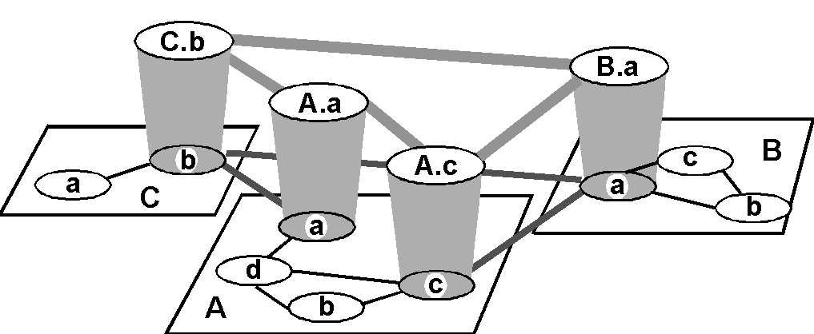
Hierarchical Routing
inter-AS border (exterior gateway) routers
intra-AS (interior gateway) routers

Slide 25
Hierarchical Routing
inter-AS border (exterior gateway) routers
AS: autonomous system
each AS uses its own IGP
internal routing protocol;
border routers run BGP
as well;
intra-AS (interior gateway) routers

Slide 26
IGP: Interior Gateway Prot
RIP
routing information protocol
OSPF
open shortest path first
Notes:
IGP: interior gateway protocols

Slide 27
RIP
Distance-vector algorithm
distance metric: # of hops (max=15)
Neighbor routers exchange routing advertisement every 30 seconds
Failure and recovery
if no update from neighbor N after 180s invalidate routes via N, notify neighbors
Notes:
Distance vector algorithm
Distance metric: # of hops (max = 15 hops)
Neighbor routers exchanged routing advertisement every 30 seconds
Failure and Recovery: If no update from neighbor N heard after 180 sec  neighbor/link declared dead
All routes via N invalidated; updates sent to neighbors
neighbors in turn may send out new advertisements (if tables changed)
Use poison reverse to prevent ping-pong loops (16 hops = ∞)

Slide 28
RIP
z
w
x
y
A
D
B
D:
routing
table
C
destination network | next router | # of hops to destination
w | A | 2
y | B | 2
z | B | 7
x | -- | 1
… | … | …

Slide 29
RIP
dest | hops
w | 1
x | 1
z | 4
… | …
advertisement
from A to D
z
w
x
y
A
D
B
D:
routing
table
C
destination network | next router | # of hops to destination
w | A | 2
y | B | 2
z | B | 7
x | -- | 1
… | … | …

Slide 30
RIP
dest | hops
w | 1
x | 1
z | 4
… | …
advertisement
from A to D
z
w
x
y
A
D
B
D:
routing
table
C
destination network | next router | # of hops to destination
w | A | 2
y | B | 2
z | B→A | 7→5
x | -- | 1
… | … | …

Slide 31
OSPF
Link-state algorithm
each node knows its direct neighbors & the link distance to each(link-state);
each node periodically broadcasts its link-state to the entire network;
Notes:
A Link State protocol
each node knows its directly connected neighbors & the link distance to each (link-state)
each node periodically broadcasts its link-state to the entire network

Slide 32
OSPF
LSP (Link-State Packet)
one entry per neighbor router:
ID of the node that created the LSP;
a list of direct neighbors, with link cost;
sequence number for this LSP (SEQ);
time-to-live (TTL) for info in this LSP;
Notes:
Link-State Packet: one entry per neighbor router
ID of the node that created the LSP
a list of direct neighbors, with link cost to each
sequence number for this LSP message (SEQ)
time-to-live (TTL) for information carried in this LSP
Use raw IP packet (protocol ID = 89)

Slide 33
OSPF
Build a complete map using link states
everyone broadcasts a piece of topology;
put all pieces together → complete map

Slide 34
OSPF
Each node stores and forwards LSPs
Decrement TTL of stored SLPs
Discard info when TTL=0
Compute routes using Dijkstra
Generate LSPs periodically with increasing SEQ
Notes:
The routing daemon running at each node: Builds and maintains topology map at each node
Stores and forwards most recent LSP from all other nodes
decrement TTL of stored LSP; discard info when TTL=0
Compute routes using Dijkstra’s algorithm
generates its own LSP periodically with increasing SEQ

Slide 35
OSPF
Reliable flooding of LSP
forward each received LSP to all neighbors but the one that sent it;
use the source-ID and SEQ to detect duplicates;
X
A
X
A
X
A
X
A
C
B
D
C
B
D
C
B
D
C
B
D
Notes:
forward each received LSP to all neighbor nodes but the one that sent it
each ISP is reliably delivered over each link
use the source-ID and SEQ in a LSP to detect duplicates
LSPs sent both periodically and event-driven

Slide 36
OSPF
All OSPF messages are authenticated
Multiple same-cost paths are allowed
Hierarchical OSPF is used in large dom
Notes:
Security: all OSPF messages authenticated
Multiple same-cost paths allowed
For each link, multiple cost metrics for different TOS (eg, satellite link cost set “low” for best effort; high for real time)
Integrated uni- and multicast support:
Multicast OSPF (MOSPF) uses same topology data base as OSPF
Hierarchical OSPF in large domains.

Slide 37
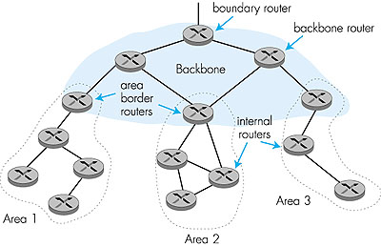
Hierarchical OSPF
Link-state ads only in area
each node has detailed
area topology,
but only direction (shortest
path) to other areas;
Notes:
Two-level hierarchy: local area, backbone.
Link-state advertisements only in area
each nodes has detailed area topology; only know direction (shortest path) to nets in other areas.
Area border routers: “summarize” distances to nets in own area, advertise to other Area Border routers.
Backbone routers: run OSPF routing limited to backbone.
Boundary routers: connect to other AS’s.

Slide 38
Hierarchical OSPF
summarize distances
to routers in local area;
advertise to
other area border routers;
Notes:
Two-level hierarchy: local area, backbone.
Link-state advertisements only in area
each nodes has detailed area topology; only know direction (shortest path) to nets in other areas.
Area border routers: “summarize” distances to nets in own area, advertise to other Area Border routers.
Backbone routers: run OSPF routing limited to backbone.
Boundary routers: connect to other AS’s.

Slide 39
Hierarchical OSPF
run OSPF routing
limited to backbone
Notes:
Two-level hierarchy: local area, backbone.
Link-state advertisements only in area
each nodes has detailed area topology; only know direction (shortest path) to nets in other areas.
Area border routers: “summarize” distances to nets in own area, advertise to other Area Border routers.
Backbone routers: run OSPF routing limited to backbone.
Boundary routers: connect to other AS’s.

Slide 40
Hierarchical OSPF
connect to
other ASes
Notes:
Two-level hierarchy: local area, backbone.
Link-state advertisements only in area
each nodes has detailed area topology; only know direction (shortest path) to nets in other areas.
Area border routers: “summarize” distances to nets in own area, advertise to other Area Border routers.
Backbone routers: run OSPF routing limited to backbone.
Boundary routers: connect to other AS’s.

Slide 41
inter-domain routing
BGP: Border Gateway Protocol
Notes:
Connect other Ases
inter-domain routing required;

Slide 42
BGP
Path-vector protocol among border routers
each border router broadcasts to neighbors entire path of AS sequence to destination:
e.g., Path(B,C) = B, A, C
Notes:
BGP (Border Gateway Protocol): the de facto standard
Path Vector protocol:
similar to Distance Vector protocol
each Border router broadcast to neighbors (peers) entire path (I.e, sequence of ASs) to destination
E.g., Path (X,Z) = X,Y1,Y2,Y3,…,Z

Slide 43
BGP
For each AS:
Obtain subnet reachability information from neighbor ASes;
Propagate the reachability information to all internal routers;
Determine routes to subnets based on reachability information and policy
Notes:
BGP (Border Gateway Protocol): the de facto standard
BGP provides each AS a means to:
Obtain subnet reachability information from neighboring ASs.
Propagate the reachability information to all routers internal to the AS.
Determine “good” routes to subnets based on reachability information and policy.
Allows a subnet to advertise its existence to rest of the Internet: “I am here”

Slide 44
BGP
Example: forwarding table entry for d→x
x
Notes:
Suppose AS A learns from the inter-AS protocol that subnet x is reachable from AS B (gateway A.c) but not from AS C.
Inter-AS protocol propagates reachability info to all internal routers.
Router d determines from intra-AS routing info that its interface I is on the least cost path to c.
Puts in forwarding table entry (x, I).

Slide 45
BGP
Example: forwarding table entry for d→x
AS A learns from BGP that subnet x is reachable from AS B via border router A.c;
x
Notes:
Suppose AS A learns from the inter-AS protocol that subnet x is reachable from AS B (gateway A.c) but not from AS C.
Inter-AS protocol propagates reachability info to all internal routers.
Router d determines from intra-AS routing info that its interface I is on the least cost path to c.
Puts in forwarding table entry (x, I).

Slide 46
BGP
Example: forwarding table entry for d→x
router d determines from intra-domain routing info that its interface I is on the least cost path to c;
x
Notes:
Suppose AS A learns from the inter-AS protocol that subnet x is reachable from AS B (gateway A.c) but not from AS C.
Inter-AS protocol propagates reachability info to all internal routers.
Router d determines from intra-AS routing info that its interface I is on the least cost path to c.
Puts in forwarding table entry (x, I).

Slide 47
BGP
Example: forwarding table entry for d→x
x
destination | next hop
x | I
Notes:
Suppose AS A learns from the inter-AS protocol that subnet x is reachable from AS B (gateway A.c) but not from AS C.
Inter-AS protocol propagates reachability info to all internal routers.
Router d determines from intra-AS routing info that its interface I is on the least cost path to c.
Puts in forwarding table entry (x, I).

Slide 48
BGP
Distribute reachability information:
with eBGP session 3a-to-1c,
AS3 sends prefix reachability info to AS1
3c
P
3a
2c
3b
2a
AS3
2b
1c
AS2
1a
1b
AS1
1d
eBGP session
iBGP session
Notes:
With eBGP session between 3a and 1c, AS3 sends prefix reachability info to AS1.
1c can then use iBGP to distribute this new prefix reach info to all routers in AS1
1b can then re-advertise the new reach info to AS2 over the 1b-to-2a eBGP session
When router learns about a new prefix, it creates an entry for the prefix in its forwarding table.

Slide 49
BGP
Distribute reachability information:
1c uses iBGP sessions to distribute
this new prefix reachability info to all routers in AS1;
3c
P
3a
2c
3b
2a
AS3
2b
1c
AS2
1a
1b
AS1
1d
eBGP session
iBGP session
Notes:
With eBGP session between 3a and 1c, AS3 sends prefix reachability info to AS1.
1c can then use iBGP to distribute this new prefix reach info to all routers in AS1
1b can then re-advertise the new reach info to AS2 over the 1b-to-2a eBGP session
When router learns about a new prefix, it creates an entry for the prefix in its forwarding table.

Slide 50
BGP
Distribute reachability information:
1b re-advertises the new reachability info to AS2
over the 1b-to-2a eBGP session;
3c
P
3a
2c
3b
2a
AS3
2b
1c
AS2
1a
1b
AS1
1d
eBGP session
iBGP session
Notes:
With eBGP session between 3a and 1c, AS3 sends prefix reachability info to AS1.
1c can then use iBGP to distribute this new prefix reach info to all routers in AS1
1b can then re-advertise the new reach info to AS2 over the 1b-to-2a eBGP session
When router learns about a new prefix, it creates an entry for the prefix in its forwarding table.

Slide 51
BGP
Distribute reachability information:
1b re-advertises the new reachability info to AS2
over the 1b-to-2a eBGP session;
when a router learns about a new prefix,
it creates a forwarding table entry for the prefix
3c
P
3a
2c
3b
2a
AS3
2b
1c
AS2
1a
1b
AS1
1d
eBGP session
iBGP session
Notes:
With eBGP session between 3a and 1c, AS3 sends prefix reachability info to AS1.
1c can then use iBGP to distribute this new prefix reach info to all routers in AS1
1b can then re-advertise the new reach info to AS2 over the 1b-to-2a eBGP session
When router learns about a new prefix, it creates an entry for the prefix in its forwarding table.

Slide 52
BGP
provider
networks
Routing policy:
Provider networks: A, B, C
Customer networks (of provider networks): X, Y, W
customer
networks
Notes:
A,B,C are provider networks
X,W,Y are customers (of provider networks)
X is dual-homed: attached to two networks
X does not want to route from B via X to C
.. so X will not advertise to B a route to C

Slide 53
BGP
provider
networks
Routing policy:
Provider networks: A, B, C
Customer networks (of provider networks): X, Y, W
X is dual-homed: attached to two networks
customer
networks
Notes:
A,B,C are provider networks
X,W,Y are customers (of provider networks)
X is dual-homed: attached to two networks
X does not want to route from B via X to C
.. so X will not advertise to B a route to C

Slide 54
BGP
provider
networks
X does not want to carry traffic from B to C,
so X will not advertise to B a route to C.
Routing policy:
Provider networks: A, B, C
Customer networks (of provider networks): X, Y, W
X is dual-homed: attached to two networks
customer
networks
Notes:
A,B,C are provider networks
X,W,Y are customers (of provider networks)
X is dual-homed: attached to two networks
X does not want to route from B via X to C
.. so X will not advertise to B a route to C

Slide 55
BGP
provider
networks
Routing policy:
A advertises to B the path AW
B advertises to X the path BAW
customer
networks
Notes:
A advertises to B the path AW
B advertises to X the path BAW
Should B advertise to C the path BAW?
No way! B gets no “revenue” for routing CBAW since neither W nor C are B’s customers
B wants to force C to route to w via A
B wants to route only to/from its customers!

Slide 56
BGP
provider
networks
Routing policy:
A advertises to B the path AW
B advertises to X the path BAW
Should B advertises to C the path BAW?
customer
networks
Notes:
A advertises to B the path AW
B advertises to X the path BAW
Should B advertise to C the path BAW?
No way! B gets no “revenue” for routing CBAW since neither W nor C are B’s customers
B wants to force C to route to w via A
B wants to route only to/from its customers!

Slide 57
BGP
provider
networks
No way!
B gets no revenue for routing CBAW as neither W nor C is B’s customer.
B wants to route only to/from its customers.
Routing policy:
A advertises to B the path AW
B advertises to X the path BAW
Should B advertises to C the path BAW?
customer
networks
Notes:
A advertises to B the path AW
B advertises to X the path BAW
Should B advertise to C the path BAW?
No way! B gets no “revenue” for routing CBAW since neither W nor C are B’s customers
B wants to force C to route to w via A
B wants to route only to/from its customers!

Slide 58
routing attacks
distance-vector
link-state
BGP

Slide 59
routing attacks
distance-vector:
announce 0 distance to all other nodes
link-state:
drop links; claim direct link to any other routers
BGP:
announce arbitrary prefix; alter paths
Notes:
Distance Vector Routing
Announce 0 distance to all other nodes
Blackhole traffic
Eavesdrop
Link State Routing
Can drop links randomly
Can claim direct link to any other routers
A bit harder to attack than DV
BGP
ASes can announce arbitrary prefix
ASes can alter path

Slide 60
Prefix Hijacking: Case 1
“The Internet”
Pakistan
Telecom
YouTube
I’m YouTube:
IP 208.65.153.0 / 22
Multinet
Pakistan
Telnor
Pakistan
Aga Khan
University
Notes:
-level of autonomous systems
-e.g., YouTube, AT&T, pakistan telecom
-routing is done on IP addresses, so when someone wants to go to YouTube they get YouTube’s IP address and YouTube announces to the world that they have the ip address and traffic is forwarded towards them. So here multinet would route to it’s provider pakistan telecom that then forwards the traffic on to youtube.
-these networks chosen for a specific reason which is that there was an incident in february 2008 pakistan telecom actually high jacked traffic going to youtube (misconfiguration).
-they announced to the world that they’re youtube and traffic destined to youtube was routed to them
-youtube was unavailable for a couple of hours as operators phone each other to figure out what was going on.

Slide 61
Here’s what should have happened….
“The Internet”
Hijack + drop packets going to YouTube
X
Pakistan
Telecom
YouTube
I’m YouTube:
IP 208.65.153.0 / 22
Multinet
Pakistan
Telnor
Pakistan
Aga Khan
University
Block your own customers.

Slide 62
But here’s what Pakistan ended up doing…
“The Internet”
No, I’m YouTube!
IP 208.65.153.0 / 24
Pakistan
Telecom
Pakistan
Telecom
YouTube
I’m YouTube:
IP 208.65.153.0 / 22
Multinet
Pakistan
Telnor
Pakistan
Aga Khan
University
Notes:
Our works focuses on attacks of this flavor..

Slide 63
Prefix Hijacking: Case 2
Level3, VZW, 22394 66.174.161.0/24
ISP 1
VZW, 22394 66.174.161.0/24
Level 3
China
Telecom
Verizon
Wireless
22394 66.174.161.0/24
22394
Paths chosen based on cost and length.
66.174.161.0/24
Notes:
B4 we start with attacks lets lookat how bgp works
We have this prefix
22.. Ann, verizon routes traffic to it, reannounces it
“ (level 3)
Some of you may remember a recent “interesting incident” that actually made it into the nytimes
Ctel ann prefix; this wrong, b\c it’s not suppose to originate
Lots of isps fell for this, we look at the data and there we a number of large isp, including thisone that remains nameless,that fell for this.
In fact we found that this happened for 50K prefix, including the DoD.
Also, even worse, renesys found that theres an interception
C tel is so big…
There have been many well publicized misconfigurations that illustrate the insecurity of BGP. For example consider the prefix on the last slide. In april 2010 China telecom announced a direct path to this prefix (as well as 50k other ones). So now ISP 1 has two paths to the prefix and needs to pick 1. Since the china telecom path is shorter ISP 1 will choose to route through it. And what’s interesting here, is that since China Telecom is so large they actually had a router in their network that still new the correct path to the prefix so the traffic went back out to level 3 and on to verizon.

Slide 64
April 2010 : China Telecom intercepts traffic
ChinaTel path is shorter
?
ChinaTel 66.174.161.0/24
Level3, VZW, 22394 66.174.161.0/24
ISP 1
Level 3
China
Telecom
Verizon
Wireless
22394
This prefix and 50K others were announced by China Telecom
Traffic for some prefixes was possibly intercepted
66.174.161.0/24
Notes:
B4 we start with attacks lets lookat how bgp works
We have this prefix
22.. Ann, verizon routes traffic to it, reannounces it
“ (level 3)
Some of you may remember a recent “interesting incident” that actually made it into the nytimes
Ctel ann prefix; this wrong, b\c it’s not suppose to originate
Lots of isps fell for this, we look at the data and there we a number of large isp, including thisone that remains nameless,that fell for this.
In fact we found that this happened for 50K prefix, including the DoD.
Also, even worse, renesys found that theres an interception
C tel is so big…
There have been many well publicized misconfigurations that illustrate the insecurity of BGP. For example consider the prefix on the last slide. In april 2010 China telecom announced a direct path to this prefix (as well as 50k other ones). So now ISP 1 has two paths to the prefix and needs to pick 1. Since the china telecom path is shorter ISP 1 will choose to route through it. And what’s interesting here, is that since China Telecom is so large they actually had a router in their network that still new the correct path to the prefix so the traffic went back out to level 3 and on to verizon.

Slide 65
Path Tampering
Remove ASes from the AS path
Add ASes to the AS path
701 3715 88
701
3715
88
?
701
701 88 →
701 3715 88
88

Slide 66
how to secure routing?

Slide 67
RPKI
X
Resource Public Key Infrastructure
certified mapping
from ASes to public keys and IP prefixes
RPKI: Invalid!
?
ChinaTel 66.174.161.0/24
Level3, VZW, 22394 66.174.161.0/24
ISP 1
Level 3
China
Telecom
Verizon
Wireless
22394
RPKI shows China Telecom is not a valid origin for this prefix.
66.174.161.0/24
Notes:
One way we might solve this is using the cry
One way to solve this is to do origin authentication using RPKI which is a certified mapping between IP prefixes and the Ases that own them. So now ISP 1 can check the RPKI and see that china telecom is not a valid orignator of this prefix and choose the correct path to the prefix.

Slide 68
RPKI
insufficient!
?
ChinaTel, 22394 66.174.161.0/24
Level3, VZW, 22394 66.174.161.0/24
ISP 1
Level 3
China
Telecom
Verizon
Wireless
22394
Malicious router can pretend to connect to the valid origin.
66.174.161.0/24
Notes:
However, if instead of just being misconfigured, china telecom decided to behave maliciously, RPKI would not be enough. So for example china telecom could pretend they have a direct connection to the AS that owns the prefix by announcing China telecom 22394.

Slide 69
S-BGP
Each AS on the path cryptographically signs its announcement
Guarantees that each AS on the path made the announcement in the path
Notes:
S-BGP: Secure BGP
Each AS on the path cryptographically signs its announcement
Guarantees that each AS on the path made the announcement in the path.
Address attestations
Claim the right to originate a prefix
Signed and distributed out-of-band
Checked through delegation chain from ICANN
Route attestations
Distributed as an attribute in BGP update message
Signed by each AS as route traverses the network
Signature signs previously attached signatures
S-BGP can validate
AS path indicates the order ASes were traversed
No intermediate ASes were added or removed

Slide 70
S-BGP
Deployment challenges:
Complete, accurate registries
Public key infrastructure
Cryptographic operations
Need to perform operations quickly
Difficulty of incremental deployment
Notes:
Complete, accurate registries
E.g., of prefix ownership
Public Key Infrastructure
To know the public key for any given AS
Cryptographic operations
E.g., digital signatures on BGP messages
Need to perform operations quickly
To avoid delaying response to routing changes
Difficulty of incremental deployment
Hard to have a “flag day” to deploy S-BGP

Slide 71

Secure Routing and Forwarding
select a path for traffic in a network
Notes:
And forwarding is the relaying of packets along a certain path,
from one network segment to another by nodes in a computer network.

Slide 72
Secure Routing and Forwarding
select a path for traffic in a network
?
relay packets along a certain path
Notes:
And forwarding is the relaying of packets along a certain path,
from one network segment to another by nodes in a computer network.

Slide 73
Forwarding Anomaly Threat
Performance
downgrade service quality
Security
bypass attacking-traffic filter

Slide 74
Path Validation
PoC: Proof of Consent
certify the provider’s consent to carry traffic along the path
PoP: Proof of Provenance
allow upstream nodes to prove to downstream nodes that they carried the packet

Slide 75
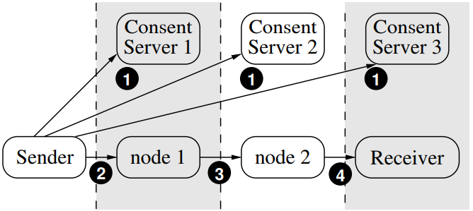
Path Validation

Slide 76
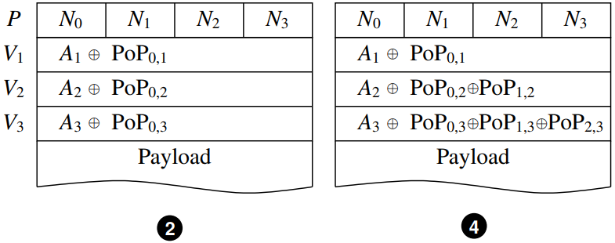
Path Validation
https://cs.nyu.edu/~mwalfish/papers/icing-conext11.pdf

Slide 77
computation-less device?

Slide 78
FlowCloak: Defeating Middlebox-Bypass Attacks in Software-Defined Networking
Middlebox
Notes:
securing middlebox policy enforcement SDN.
In this work, we identify a new kind of attack named Middlebox-Bypass Attacks and present corresponding countermeasure.

Slide 79
Middlebox
Notes:
But let’s take our time and start from a hot topic recent years, middlebox first.

Slide 80
Needs
Varieties of functions: Security & Performance
Widely deployed: A third of network devices
Middlebox:
Pain Spot in
modern networks
Troubles
Deployment and configuration:
Complex & Error-prone
Costs: Personnel, Money, Time
Notes:
Whereas, middleboxes gradually become a pain spot in modern networks. This pain comes from both significant needs and endless troubles. Because critical functions beyond switches like security and performance enhancement can be provided by middleboxes, they have been widely deployed in every kind of network. In average, about a third part of a network is comprised of middleboxes. Nevertheless, troubles brought by middleboxes are also far beyond switches as deployment of middleboxes is complex and error-prone. This further costs more personnel, money and time.

Slide 81
Middlebox:
Pain Spot in
modern networks
Notes:
Let me illustrate the complexity in configuring a middlebox policy chain in traditional networks.

Slide 82

Middlebox:
Pain Spot in
modern networks
NAT
Light Firewall
Heavy Firewall
Rules
Rules
Rules
Notes:
In this example, Supposing our administrator would like network flows to pass NAT, Light Firewall and Heavy Firewall in order. He has to write and install rules on all of these switches, which may provide different user interfaces.

Slide 83
Middlebox:
Pain Spot in
modern networks
NAT
Light Firewall
Heavy Firewall
?
Notes:
Once the number of switches increases, this is going to severely confuse our poor administrator.

Slide 84

Middlebox:
Pain Spot
NAT
Light Firewall
Heavy Firewall
SDN
Controller
Notes:
Among many methods providing a more friendly and automatic way to enforce policies, SDN is most widely adopted because it requires no significant change on existing network infrastructure.

Slide 85
Middlebox:
Pain Spot
NAT
Light Firewall
Heavy Firewall
SDN
Rules
Rules
Rules
Controller
Policies
Notes:
The controller of SDN has global view and connection of the whole network. It is able to transform a set of user policies to switch-readable rules and install them. Our administrator can now concentrate only on middlebox-ralated policies through a human-friendly interface. As we can see, SDN has kicked away the pain spot arising from middleboxes.

Slide 86
Middlebox meets
SDN
NAT
Light Firewall
Heavy Firewall
Rules
Rules
Rules
Controller
Policies
Notes:
However, it leaves us a more subtle problem of forwarding ambiguity when middlebox meets SDN.

Slide 87
Middlebox meets
SDN
NAT
Light Firewall (LF)
Heavy Firewall (HF)
H1
S1
S2
S3
L_{E}
Rules
Rules
Rules
H2
Policies:
(1) H1 — NAT — L_{E}
(2) H2 — NAT — LF — HF — L_{E}
Controller
Policies
Alert
Forwarding Ambiguity
Notes:
Consider this simple topology again where our administrator needs to enforce these two policies. He wants all the traffic from H2 to be filtered by LF and if necessary, HF. Meanwhile, packets from H1 simply traverse NAT and go out.

Slide 88
Middlebox meets
SDN
NAT
Light Firewall (LF)
Heavy Firewall (HF)
H1
S1
S2
S3
L_{E}
Rules
Rules
Rules
H2
Policies:
(1) H1 — NAT — L_{E}
(2) H2 — NAT — LF — HF — L_{E}
Controller
Policies
Alert
Forwarding Ambiguity
Notes:
Under this condition, S2 and S3 will have great difficulties judging the source address of a packet.

Slide 89
Middlebox meets
SDN
Ip_src:
H1→?
H2→?
NAT
Light Firewall (LF)
Heavy Firewall (HF)
H1
S1
S2
S3
L_{E}
?
Rules
Rules
?
Rules
H2
Policies:
(1) H1 — NAT — L_{E}
(2) H2 — NAT — LF — HF — L_{E}
Controller
Policies
Alert
Forwarding Ambiguity
Notes:
Because NAT changes IP address of each packet to an unexpected address.

Slide 90
Middlebox meets
SDN
NAT
Light Firewall (LF)
Heavy Firewall (HF)
H1
S1
S2
S3
L_{E}
Rules
Rules
?
Rules
H2
Policies:
(1) H1 — NAT — L_{E}
(2) H2 — NAT — LF — HF — L_{E}
Controller
Policies
Alert
Forwarding Ambiguity
Notes:
Forwarding suspicious packets identified by LF is also problematic for the same reason on S3.

Slide 91
Middlebox meets
SDN
NAT
Light Firewall (LF)
Heavy Firewall (HF)
H1
S1
S2
S3
L_{E}
Stateless
H2
Policies:
(1) H1 — NAT — L_{E}
(2) H2 — NAT — LF — HF — L_{E}
Alert
Notes:
The intrinsic problem lies in the stateless and memoryless nature of IP network layer.

Slide 92
Middlebox meets
SDN
NAT
Light Firewall (LF)
Heavy Firewall (HF)
H1
S1
S2
S3
L_{E}
Stateless→Stateful
H2
Policies:
(1) H1 — NAT — L_{E}
(2) H2 — NAT — LF — HF — L_{E}
Alert
Notes:
So making the network stateful would solve the forwarding ambiguity,

Slide 93
Middlebox meets
SDN
NAT
Light Firewall (LF)
Heavy Firewall (HF)
Switch | Some Crucial Rules
 | Matching | Action
S2 | tag=<src:H2, NAT>, interface=S2:S1 | fwd(LF)
S2 | tag=<src:H1,NAT>, interface=S2:S1 | fwd(S3)
S3 | tag=<src:H2, LF, alert>, interface=S3:S2 | fwd(HF)
S3 | tag=<src:H2, LF, pass> Interface=S3:S2 | fwd(L_{E})
H1
S1
S2
S3
L_{E}
Flowtags [NSDI ’14]
Stateful Tags on packer header
H2
Policies:
(1) H1 — NAT — L_{E}
(2) H2 — NAT — LF — HF — L_{E}
Alert
Notes:
Flowtags in 2014 on NSDI suggests middleboxes add stateful tags on each packet header and controller install corresponding rules on switches. For example, after NAT tags packets, S2 can identify orgin of packets by matching tag field with first two rules. The second policy can be enforced with rules on S3 in a similar way.

Slide 94

Middlebox meets
SDN
Middlebox-Bypass Attacks
Middlebox
NAT
Light Firewall (LF)
Heavy Firewall (HF)
Switch | Some Crucial Rules
 | Matching | Action
S2 | tag=<src:H2, NAT>, interface=S2:S1 | fwd(LF)
S2 | tag=<src:H1,NAT>, interface=S2:S1 | fwd(S3)
S3 | tag=<src:H2, LF, alert>, interface=S3:S2 | fwd(HF)
S3 | tag=<src:H2, LF, pass> Interface=S3:S2 | fwd(L_{E})
H1
S1
S2
S3
L_{E}
H2
Policies:
(1) H1 — NAT — L_{E}
(2) H2 — NAT — LF — HF — L_{E}
Alert
Notes:
However, lack of consideration on security makes a new kind of attack – middlebox-bypass attack possible. In a middlebox-bypass attack, the attacker completely controls some switches, say S2. Then he tries to bypass the security inspection by middleboxes, say LF here by violating the first rule on S2.

Slide 95
Middlebox-Bypass Attacks
NAT
Light Firewall (LF)
Heavy Firewall (HF)
Switch | Some Crucial Rules
 | Matching | Action
S2 | tag=<src:H2, NAT>, interface=S2:S1 | tag(LF, pass) fwd(HF)
S2 | tag=<src:H1,NAT>, interface=S2:S1 | fwd(S3)
S3 | tag=<src:H2, LF, alert>, interface=S3:S2 | fwd(HF)
S3 | tag=<src:H2, LF, pass> Interface=S3:S2 | fwd(L_{E})
H1
S1
S2
S3
L_{E}
Leads to:
Severe security breaches
Performance degradation
H2
Policies:
(1) H1 — NAT — L_{E}
(2) H2 — NAT — LF — HF — L_{E}
Alert
Notes:
Compromised switch S2 first tags the packets as if it had been processed by LF with a non-suspicious result. Then it directly forwards packets to S3.Hence, S3 will deem these packets as benign and forward them out. This kind of attacks lead to severe security breaches as well as performance degradation when the middlebox is a proxy or load balancer.

Slide 96
Middlebox-Bypass Attacks:
More than Hypothesis
NAT
Light Firewall (LF)
Heavy Firewall (HF)
Switch | Some Crucial Rules
 | Matching | Action
S2 | tag=<src:H2, NAT>, interface=S2:S1 | fwd(LF)
S2 | tag=<src:H1,NAT>, interface=S2:S1 | fwd(S3)
S3 | tag=<src:H2, LF, alert>, interface=S3:S2 | fwd(HF)
S3 | tag=<src:H2, LF, pass> Interface=S3:S2 | fwd(L_{E})
H1
S1
S2
S3
L_{E}
Leads to:
Severe security breaches
Performance degradation
H2
Policies:
(1) H1 — NAT — L_{E}
(2) H2 — NAT — LF — HF — L_{E}
Alert
Notes:
Some of you may wonder if it is realistic to compromise a switch in an SDN.

Slide 97
Middlebox-Bypass Attacks:
More than Hypothesis
NAT
Light Firewall (LF)
Heavy Firewall (HF)
H1
S1
S2
S3
L_{E}
Without SSL
H2
Benton et al.
Attacking insecure channel
Notes:
Unfortunately, different attacking methods have already been proposed. Benton et al. find some controller-switch channels are not encrypted by SSL/TLS. The attacker would know how to install arbitrary rules on switches after eavesdropping these channels.

Slide 98
Middlebox-Bypass Attacks:
More than Hypothesis
NAT
Light Firewall (LF)
Heavy Firewall (HF)
H1
S1
S2
S3
L_{E}
Insecure firmware,
e.g. ONIE
Insecure NOSes
H2
Pickett @ DEFCON
Notes:
Pickett @ DEFCON shows us how to leverage insecure firmware and insecure Network Operating Systems on switches to hijack them.

Slide 99
Middlebox-Bypass Attacks:
Existing malicious switch detection methods
Probe-based Methods
Blinded by coward-attack
Waste valuable control channel bandwidth
Statistics-based Methods
False positive (negative)
Waste valuable control channel bandwidth
Notes:
Of course we are not the first one detecting malicious switches in SDN, but are the other ones effective enough for middlebox-bypass attacks? As far as we know, these methods can be divided into Probe-based ones and statistics-based ones. Probe-based methods, however, could be easily blinded by coward-attack, which can distinguish probing packets and production packets and attack only production packets. Statistics-based methods collect statistics of the same flow on each switch en-route. The statistics may fluctuate across switches but when fluctuation exceeds threshold, corresponding switch is deemed malicious. These methods are threshold-based so false positives(negatives) are usually inevitable. Besides, both of the two kinds of methods waste valuable control channel bandwidth to report probe or statistics information to the controller.

Slide 100
Probe-based Methods
Blinded by coward-attack
Waste valuable control channel bandwidth
Middlebox-Bypass Attacks:
Existing Secure Methods
Statistics-based Methods
False positive (negative)
Waste valuable control channel bandwidth
Notes:
In conclusion, they cannot be counted as existing secure methods for middlebox-bypass attacks.

Slide 101
FlowCloak
FlowCloak: Defeating Middlebox-Bypass Attacks in Software-Defined Networking
Middlebox-Bypass Attacks
Notes:
Thus, we present FlowCloak, to address the problem with high accuracy and efficiency.

Slide 102

FlowCloak:
Model
NAT
Light Firewall
Heavy Firewall
？
？
H1
S1
S2
S3
L_{E}
Rules
Rules
Rules
H2
Controller
Notes:
Let me introduce adversary model first. The Controller of an SDN is often deemed secured because it is the root of security and administrators never overlook its importance. All of the middleboxes are benign, too as they often have enough computation resource to protect them from attacks. Moreover, we assume security of the egress switch. There are solutions protecting a single switch, which are too expensive for widely applying. An attacker is able to compromise any other switches in the network. A compromised switch will try every effort to bypass a middlebox.

Slide 103
FlowCloak:
Architecture
ptag verification
NAT_{FlowCloak}
LF_{FlowCloak}
HF_{FlowCloak}
H1
S1
S2
S3
L_{E}
No Cryptography Computation on Switches
Policies:
(1)H1—NAT — L_{E}
(2)H2 — NAT — LF —HF —L_{E}
H2
dtag | ptag
Alert
FlowCloak Tag
Notes:
In FlowCloak, we still adopt a tag to mark a packet’s state and origin, named derterministic tag. However, we add another tag which we call probabilistic tag(ptag). Ptag acts as a proof that the packet is actually processed by the middlebox indicated by the dtag. Each middlebox distributedly verifies ptag set by the former one. As an example here, LF needs to verify ptag of NAT, then followed by HF. The egress switch S3 verifies ptags from NAT, LF or HF for different packets. What’s more, due to limited computational resource on switches, the egress switch is not capable of cryptography computations. So we must consider it as a special condition. This divides our work into two parts: FlowCloak with mb only & another part with egress switch included. Let’s start from an easier condition, mb vs. mb…

Slide 104
FlowCloak:
Architecture
NAT_{FlowCloak}
LF_{FlowCloak}
Notes:
////In this case, a middlebox downstream verification device is another middlebox.

Slide 105
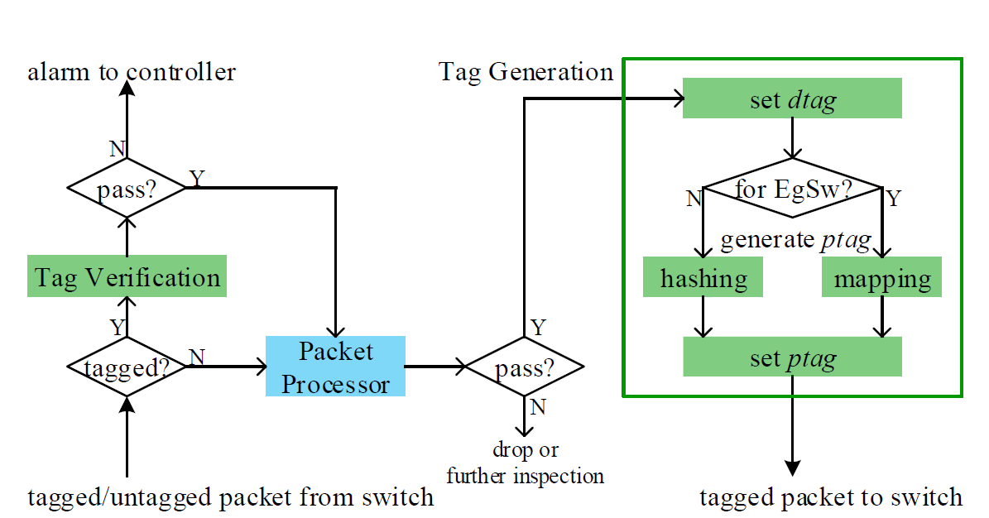
FlowCloak:
Middlebox vs. Middlebox
NAT_{FlowCloak}
LF_{FlowCloak}
Packet Processing Logic on FC Middleboxes
Notes:
FlowCloak adds tag verification and tag generation modules to middleboxes.

Slide 106
FlowCloak:
Middlebox vs. Middlebox
NAT_{FlowCloak}
LF_{FlowCloak}
TAGVERIFICATION(P) if isexist(P. dtag, dtagmap) then ptag’ = Hash(Sample(P. Header)) if(ptag’ == P.Header.ptag) return TRUE return FALSE TAGVERIFICATION ends
Packet Processing Logic on FC Middleboxes
Notes:
Tag Verification module verifies both a packet‘s dtag and ptag.

Slide 107
FlowCloak:
Middlebox vs. Middlebox
TAGGENERATION(P) if next_dev(P) == DEV.MIDDLEBOX then dtag = flowtags(P, self.ID, Controller) writedtag(P, dtag) ptag = Hash(Sample(P. Header)) writeptag(P, ptag) else ptag = Map(Sample(P. Header)) TAGGENERATION ends
Packet Processing Logic on FC Middleboxes
Notes:
Tag generation tags the packet with new ptag, which is generated by hashing over certain sample fields. Whereas, if next device is an egress switch, we adopt a faster hashing function to generate multiple tags, called mapping function here. To figure out how it works, we shall study how an egress switch verifies ptags.

Slide 108
FlowCloak:
Middlebox vs. Switch
No cryptography computation: Simulating the hashing function using only match-forward rules
Egress Switch Rules
Matching | Action
P.SampleDomain=0 && P.Header.ptag=1 | forward
P.SampleDomain=1 && P.Header.ptag=0 | forward
Hash(b)=~b:
Hash(0)=1
Hash(1)=0
Notes:
As no cryptography computation is allowed on an egress switch, it needs to simulate the hashing function with only match-forward rules. Here we give a simple example on how to simulate this hashing function below. //The input of the hashing function is the sample domain and ptag field is its ouput.

Slide 109
FlowCloak:
Middlebox vs. Switch
No cryptography computation: Simulating the hashing function using only match-forward rules
Satisfying Security means Sufficient Rules
Egress Switch Rules
Matching | Action
P.SampleDomain=0 && P.Header.ptag=1 | forward
P.SampleDomain=1 && P.Header.ptag=0 | forward
Hash(b)=~b:
Hash(0)=1
Hash(1)=0
Notes:
Obviously, security of this hashing function is far from enough. We need one with a longer input and output, which needs more rules to simulate.

Slide 110
FlowCloak:
Middlebox vs. Switch
Length(P.SampleDomain)=1
2 rules;
…
Length(P.SampleDomain)=n
2^{n} rules;
Too many rules for limited TCAM capacity
Egress Switch Rules
Matching | Action
P.SampleDomain=0 && P.Header.ptag=1 | forward
P.SampleDomain=1 && P.Header.ptag=0 | forward
Hash(b)=~b:
Hash(0)=1
Hash(1)=0
Notes:
But the number of rules increase exponentially as bit length of input grows, which means the limited TCAM memory on egress switch can be easily run out. Nevertheless, we find that taking full use of multiple flow tables can significantly decrease the number of rules.

Slide 111
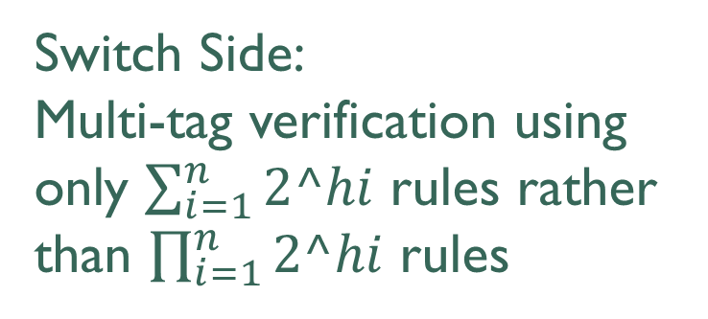
FlowCloak:
Middlebox vs. Switch
h1 bits | h2 bits | h3 bits
Multi-tag technology
Middlebox Side:
Multi-tag generation based on parallel generation and hashing table.
g1 | g2 | g3
Switch Side:
Multi-tag verification using only $\sum_{i=1}^{n}{2^hi}$ rules rather than $\prod_{i=1}^{n}{2^hi}$rules
Flow Table 1
Flow Table 2
Flow Table 3
Notes:
To put it in detail, on middlebox side, we divide the sample field into different parts first and then hash them respectively. We combine the hashing results together to form the ptag. On the switch side, we leverage pipelined multiple flow tables to verify each part of the ptag. Assume length of each part of sample field is h_i. The number of needed rules dramatically decreases from the product of 2 to h_i to the sum of them.

Slide 112
FlowCloak:
Middlebox vs. Switch
h1 bits | h2 bits | h3 bits
Caveat:
Each tag becomes shorter
→Attacking each part becomes easier?
g1 | g2 | g3
Flow Table 1
Flow Table 2
Flow Table 3
Notes:
But length of each part of tag is definitely shorter than the original ptag. It’s a caveat whether an attack on partial ptag becomes easier.

Slide 113
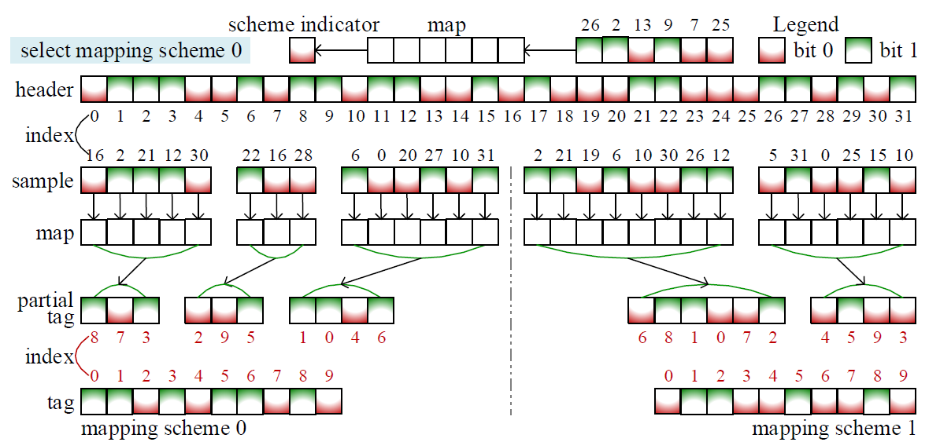
FlowCloak:
Middlebox vs. Switch
Shuffle 1
Shuffle 2
More sophisticated mapping:
multiple mapping schemes + nonconsecutive sample bits + double shuffle
Notes:
Keeping this in mind, we suggest applying a set of different mapping scheme for different packets. What’s more, we sample nonconsecutive bitss in packet headers and shuffle these bits before and after mapping. With this more sophisticated mapping method, we are sure that FlowCloak is highly secured because attackers know nothing about which field to sample, how to shuffle or which mapping scheme is chosen. Furthermore, we suggest periodically changing to different mapping schemes.

Slide 114
Review
Routing
Routing Attacks
Secure Routing
Secure Forwarding
Secure SDN Forwarding

Slide 115
?

Slide 116
Readings
BGP Hijack Explained by Jorge Ribas
Why Is It Taking So Long to Secure Internet Routing? by Sharon Goldberg
FlowCloak: Defeating Middlebox-Bypass Attacks in Software-Defined Networking

Slide 117
Thank You
be on the road
Notes:
Run your own race.

